Slide 1
Los museos de ciudad: metrópolis y barrios en red
MUHBA & CIDEU,
23 de noviembre de 2023

Slide 2
Los museos de ciudad: metrópolis y barrios en red
Los museos de ciudad pueden explicar la trayectoria de las metrópolis a lo largo del tiempo, a través de sus exposiciones e itinerarios urbanos, y pueden ser un instrumento decisivo para la construcción de una ciudadanía socialmente más inclusiva.
El conocimiento histórico y comparativo entre barrios y entre ciudades se convierte en una perspectiva fundamental para la democracia urbana. Durante la sesión se comentarán situaciones y modelos operativos para avanzar con este objetivo en los próximos años.

Slide 3
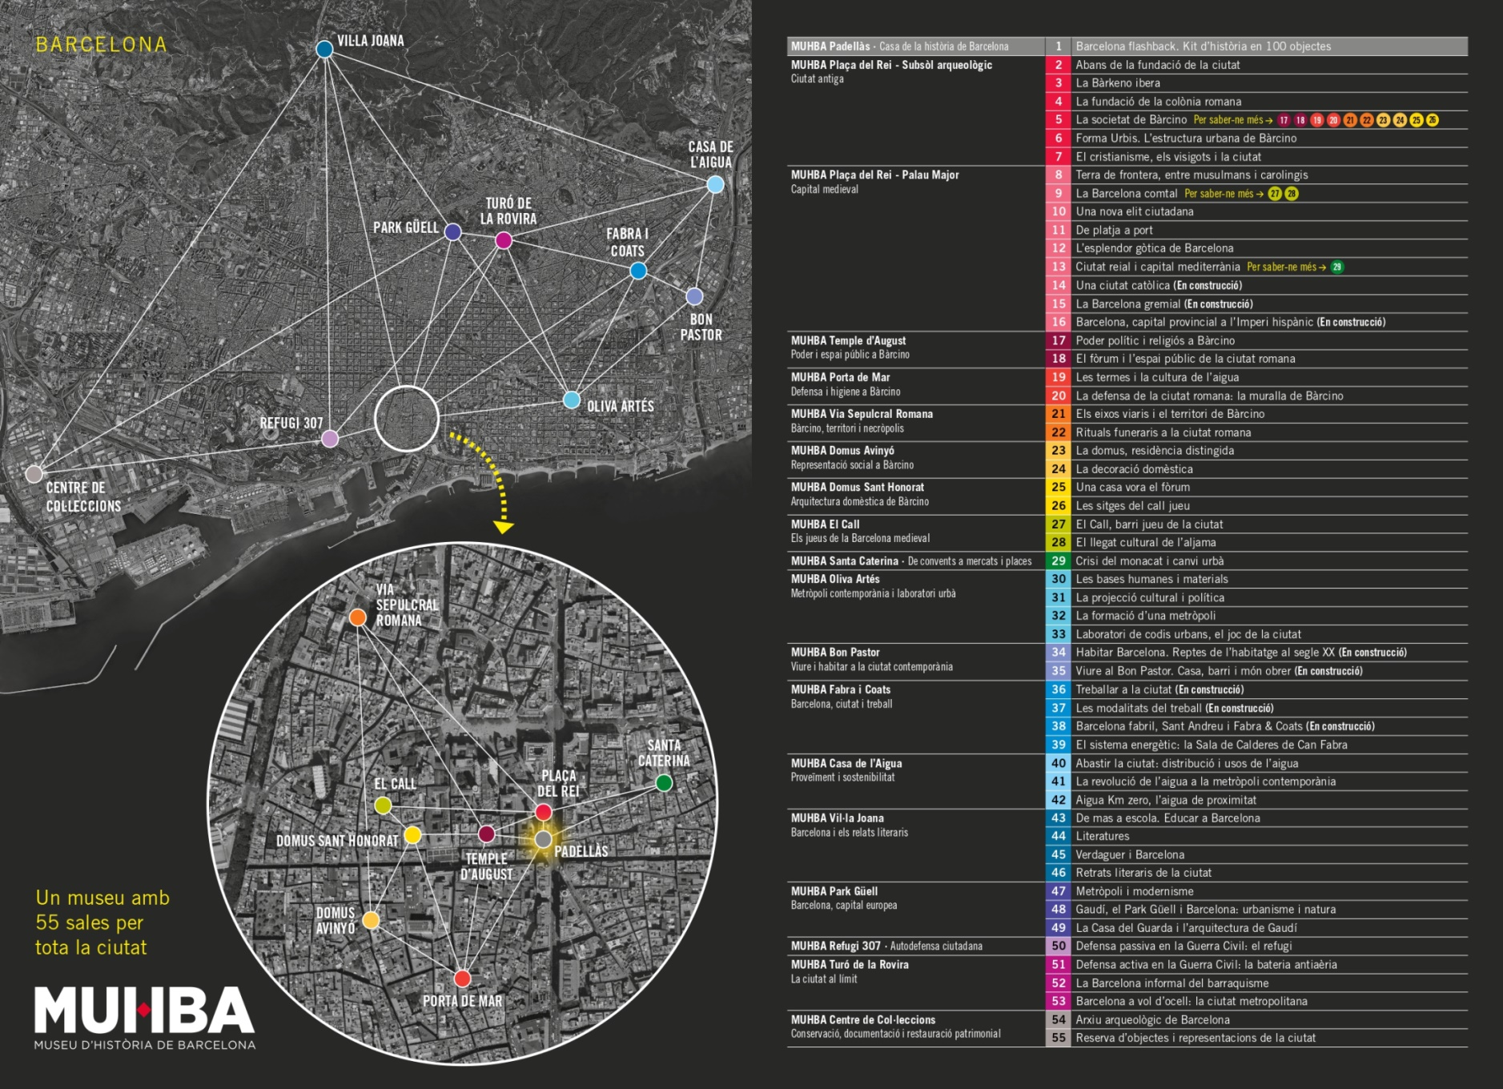
Strategic spaces: A city museum in the city, in 15 places containing 55 museum rooms

Slide 4
A new conception of cultural polarities: Public-comunitarian management

Slide 5
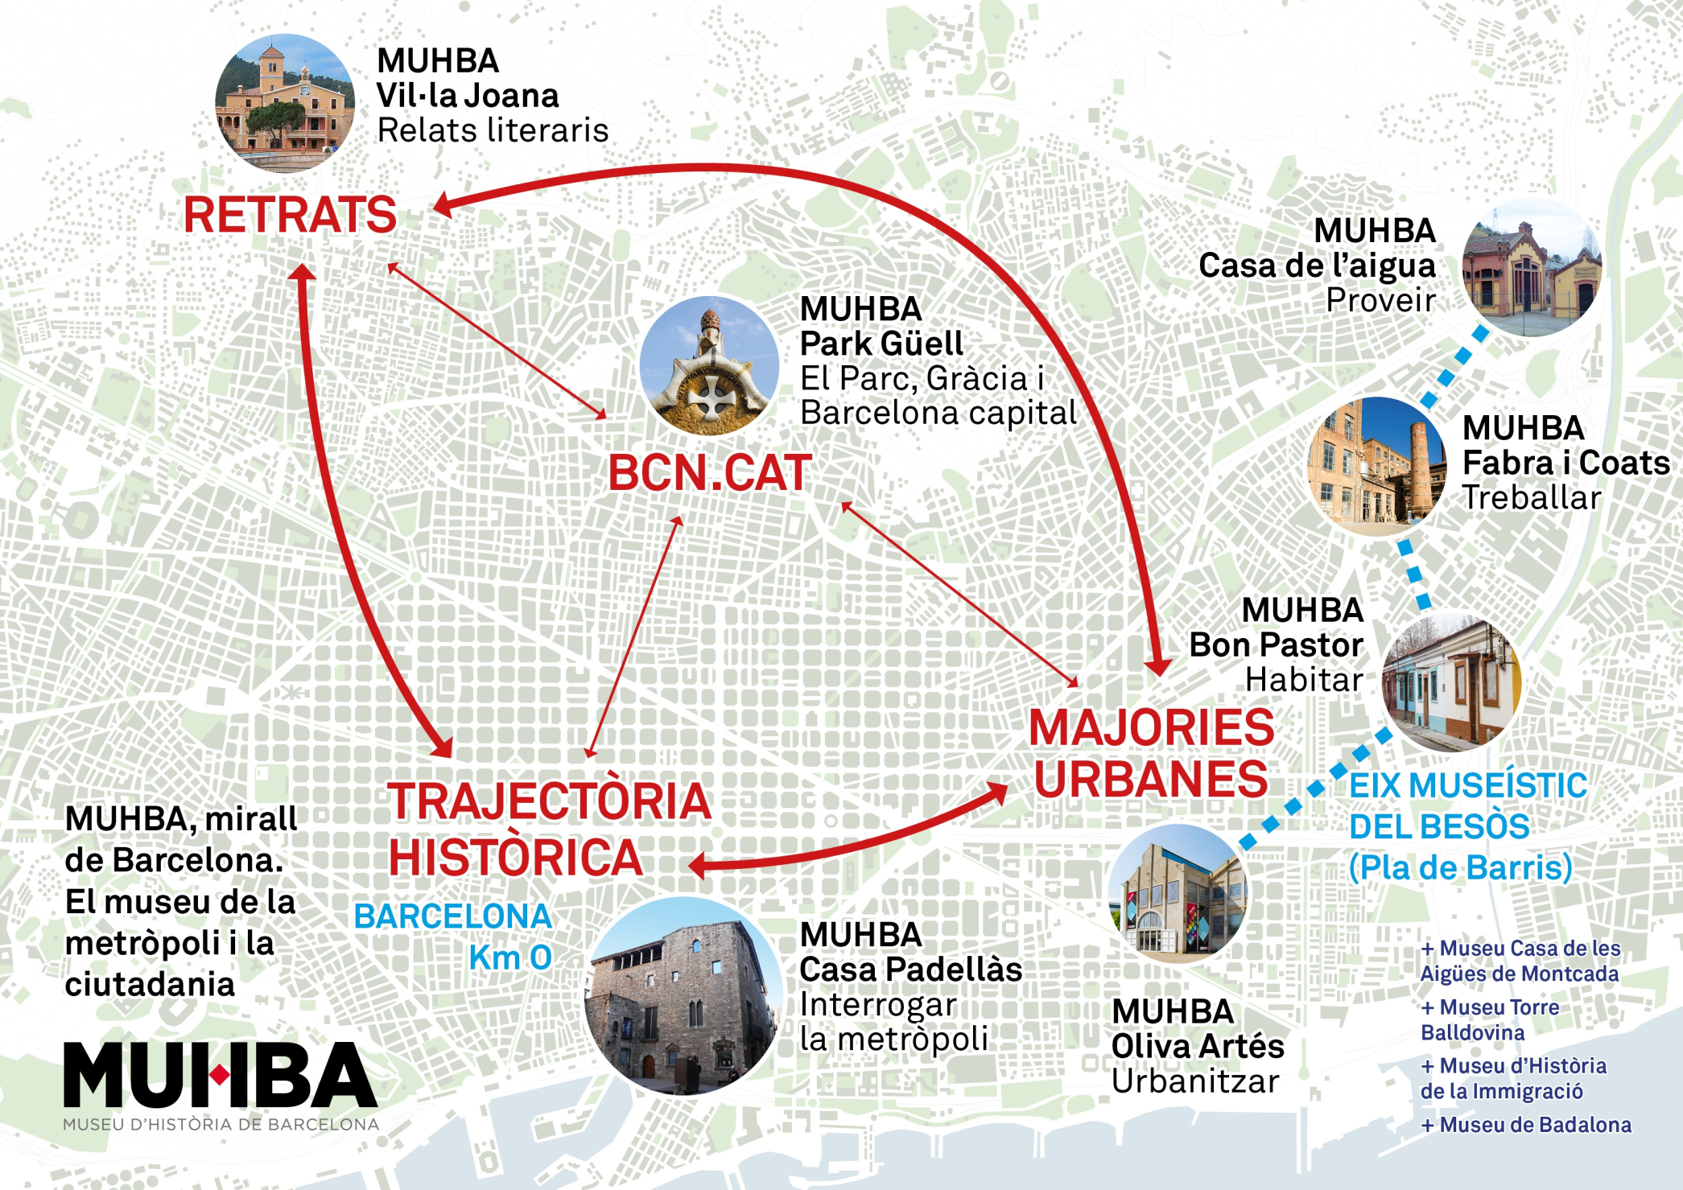

Slide 6
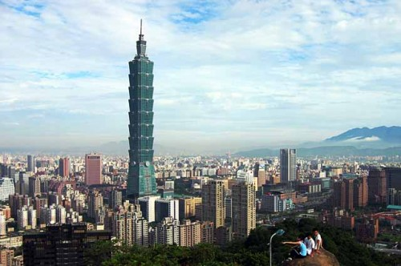
The Barcelona Declaration Principles…
Cities bear a unique urban history, tradition and culture. They also are places of creativity, innovation and change, crucial aspects for the future.
City Museums: aim to play a key role by favouring civic dialogue, provoking unpredictable opinions and emotions.
As places visited by residents and tourists alike, they reflect on the very concept of the city as a source of heritage and of future growth, to be cherished and shared.
From this common ground, such museums can promote the role of cities.
The Barcelona Declaration intends to offer common profile delineation, with a main theme and object of study: cities and their citizens.
History and Heritage
Academic Platform
Urban Network
Educational Function
Meeting Point
R+D+i centres
Tourism
City Museums and Identity
Taipeh

Slide 7
SO, cITY MUSEUMS AS Mirrors and gateways of cities CAN BE...
Research centres on cities’ history and heritage, with significant connections in the academic world and with local scholarly associations.
A common home for knowledge: research, heritage spaces, exhibitions and public outreach with varying interests in the general framework of urban history.
Creators of Collections and representative heritage spaces belonging to the city as a whole and its residents.
A network of heritage & history meeting points throughout the city, expressing the periphery, reweaving the centre and narrating the city.
Institutions rooted in the city and open to the world, with a historical perspective in the narrative of the metropolis and its heritage.
Civic laboratories for residents, immigrants and tourists, a forum for the appropriation of the city.
A top-class urban economic agent for the city, in addition to the visitor figures and revenues obtained by the museum.

Slide 11
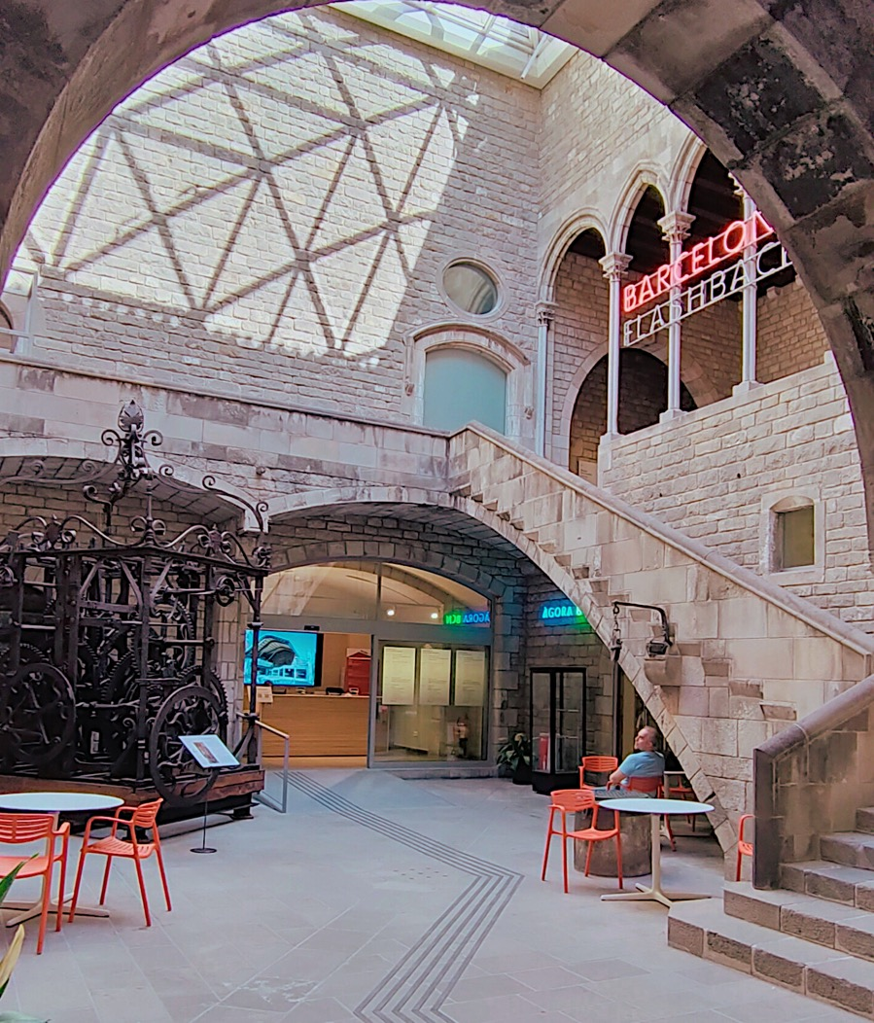
El nuevo museo de la ciudadanía, 2023
INVESTIGACIÖN Y PUBLICACIONES EN
HISTORIA URBANA
WEB Y MUSEO VIRTUAL COMO HUB DE CONOCIMIENTO
ESPACIOS URBANOS REPRESENTATIVOS
COGESTIÓN CON LOS CIUDADANOS
Notes:
This year 2023, the Barcelona History Museum has celebrated its 80th Anniversary, reformulating the city museum into a CITIZENS museum.
A transformation process of many years, based on a THEORETICAL AND CONCEPTUAL reformulation of the Museum and developed in the RENOVATION of some of its heritage spaces and the CREATION of some others.
In the photo you see the Padellàs House, the headquarters of the Museum, converted into the House of History of Barcelona, with a new covered patio and adjoining rooms that shape the Àgora Museum, a meeting point for citizens with free circulation and with accessible resources for learning about the history of the city, and where the School Museum has also been consolidated and the Centre for Research, Documentation and Debate has been strengthened.

Slide 12
MUHBA BON PASTOR
Notes:
We will focus, however, on the case of Bon Pastor, but taking in mind that it was just one of the multiple projects done at the same time. It’s just one of the pool balls.
Bon Pastor is a space on the outskirts, in the East of the city, an area with few recognized heritage elements and museums but with a very active social fabric, many study centers that promote and support cultural initiatives. Therefore, a very dynamic space but also unpredictable and very flexible

Slide 13
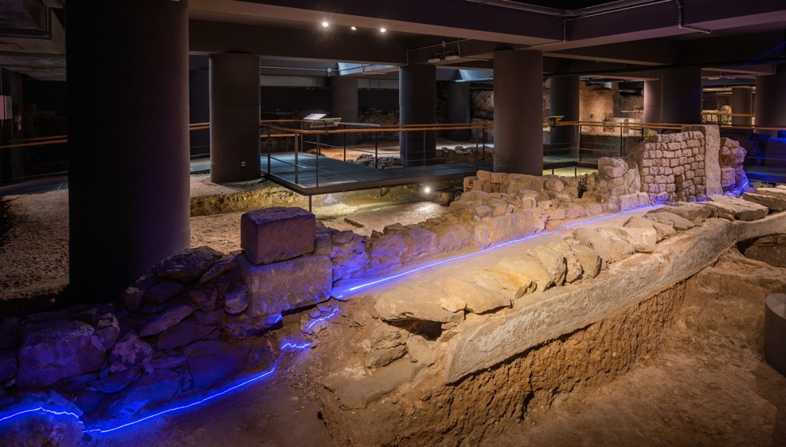
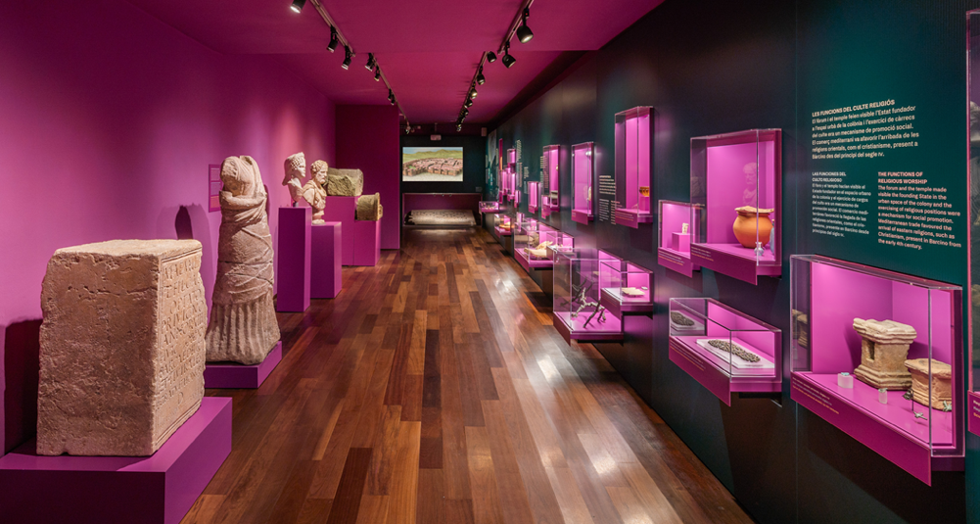
MUHBA BARCINO
Ancient City
Notes:
... We have opened the new museography of the Roman archaeological underground, paying particular attention to urban history and comparative reflection with other cities

Slide 14
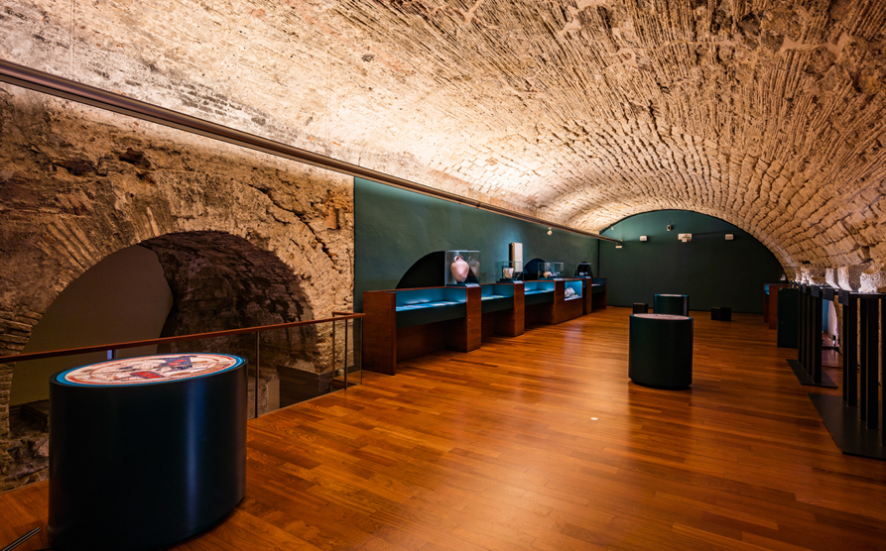
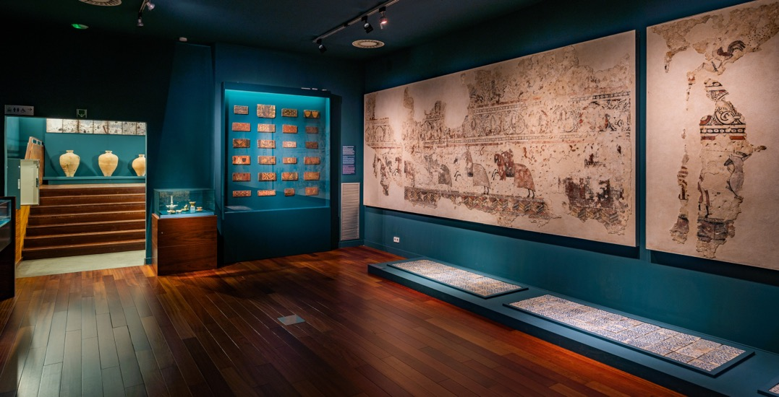
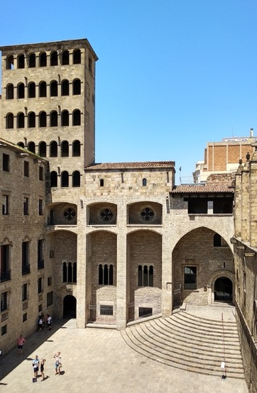
MUHBA PALAU MAJOR
Medieval capital
Notes:
Also part of the medieval rooms of the Royal Major Palace

Slide 15
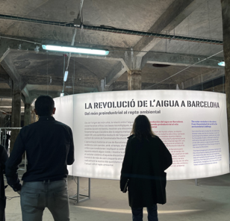
MUHBA CASA DE L’AIGUA
Supply and sustainability
Notes:
... An open for works at Casa de l'Aigua to show the process of the projects to the citizens, making them participate from the first stages...

Slide 16
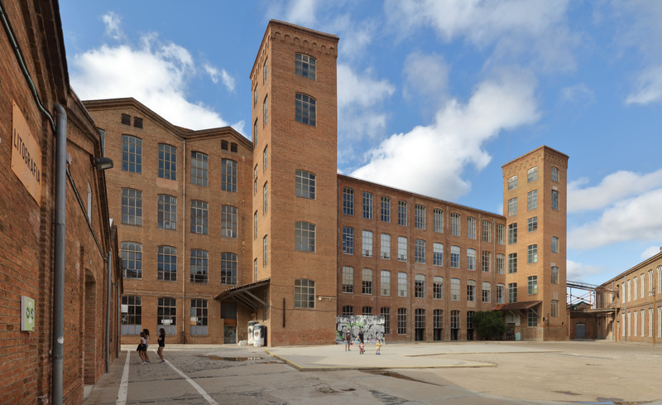
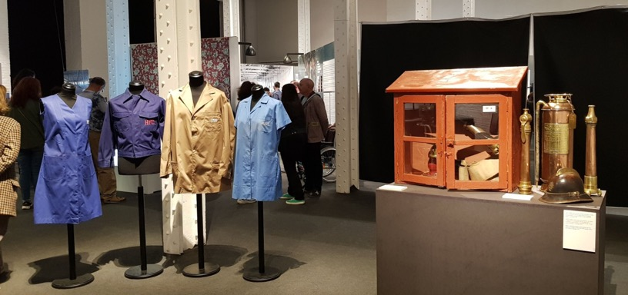
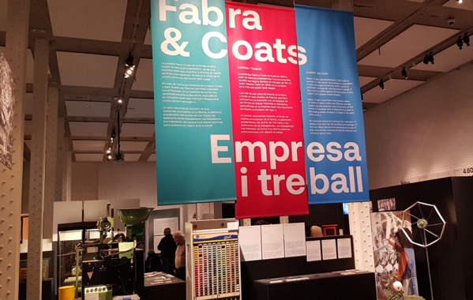
MUHBA FABRA I COATS
City and work
Notes:
...Or experimental exhibitions, like the one we did in Fabra and Coats, to evaluate in a first stage the project we are currently carrying out and which is scheduled to finish at the end of the next year

Slide 17
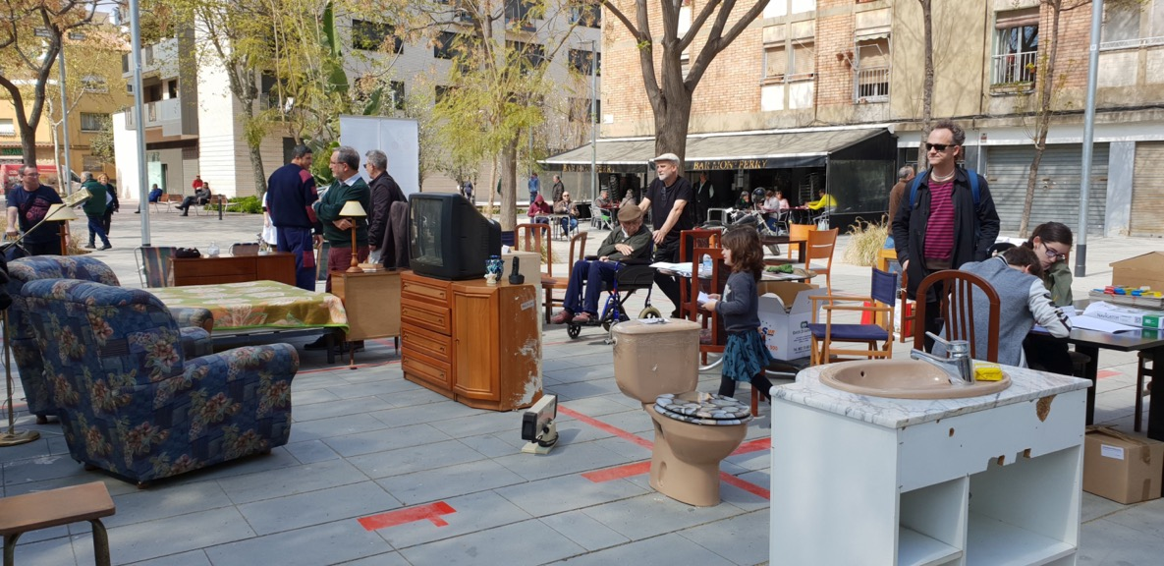
Migration and social housing: Creating participatory projects with communities
MUHBA BON PASTOR
New York CAMOC Conference 2023
Notes:
What I am coming to present to you VERY BRIEFLY together with my colleagues who are in Barcelona, is the new space of the Barcelona History Museum, the MUHBA Bon Pastor site, inaugurated last March, from where we explain the history of contemporary housing in Barcelona, as a necessary space to explain the historical trajectory of the city. In this case, we are focused on social housing, in which the issue of migration is embedded, and which we treat from a long-term perspective (*)

Slide 18
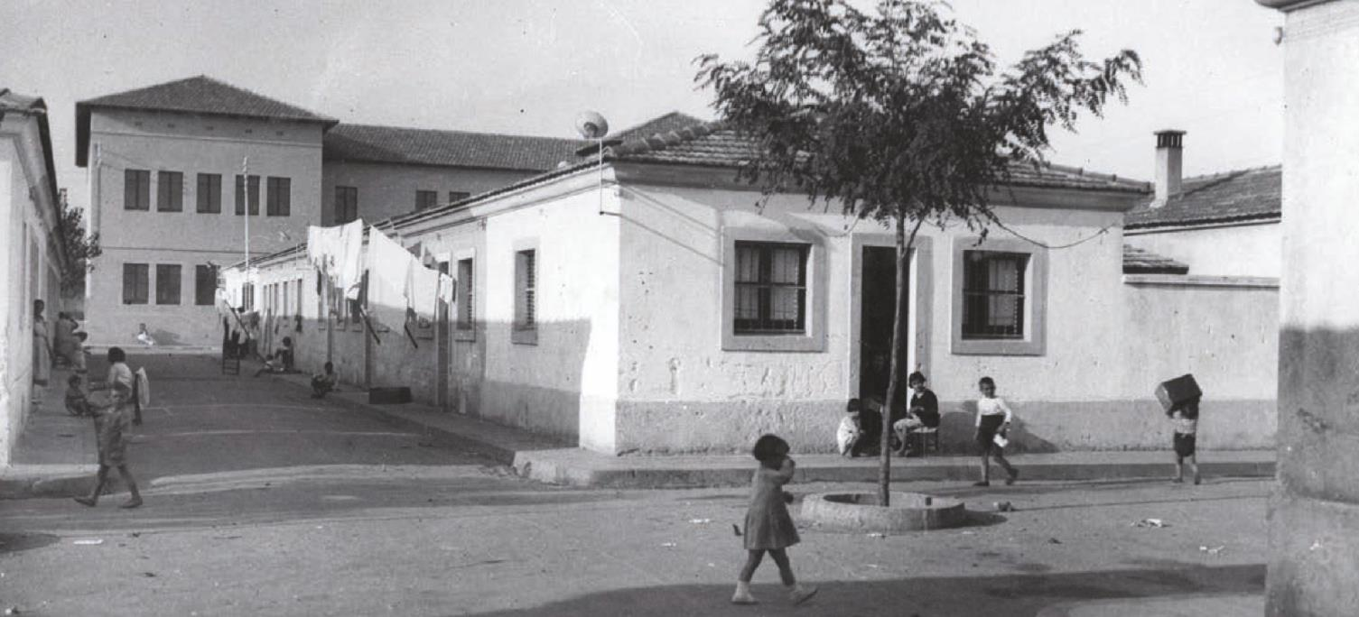
Notes:
…. in order to relocate the shanty inhabitants that lived in Montjuic at the moment of the International Exhibition.
In 2002 it was approved the reconstruction of the whole estate, substituting the original houses by new residential blocks…

Slide 19
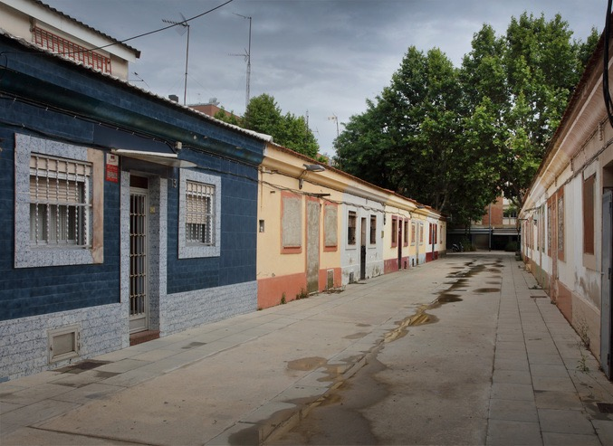
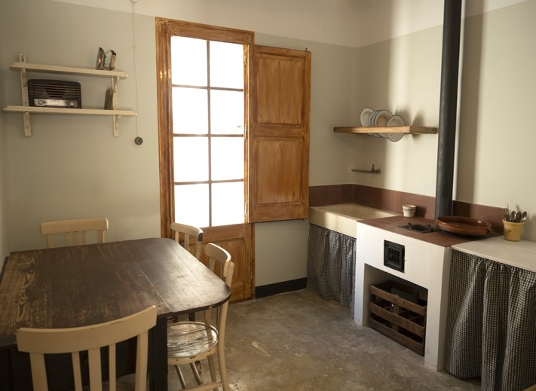
MUHBA BON PASTOR
Inhabiting the contemporary city
Notes:
The opening of the new branch of the Museum, Bon Pastor, that I’ll explain later

Slide 20
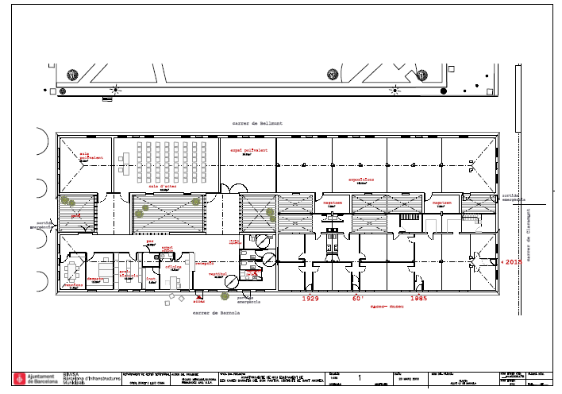
A shared project
Foto projecte
Notes:
What has been done is to preserve a block of houses, 16 in total, 8 for various equipments, the study center, a multipurpose room and so on, and 8 more that make up the exhibition part (which I will focus on).

Slide 21
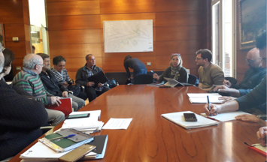
Comanagement model
Museum – ICUB (municipality)
District
Entities
Notes:
…a CO-MANAGED PROJECT, as we said before, with
1.the entities (study centers, institutions and local archives, also universities) and specially the initiative of the Residents' Association of Bon Pastor
2. the Museum, linked to the ICUB-City Council
3. and with the backing of the Sant Andreu district

Slide 22
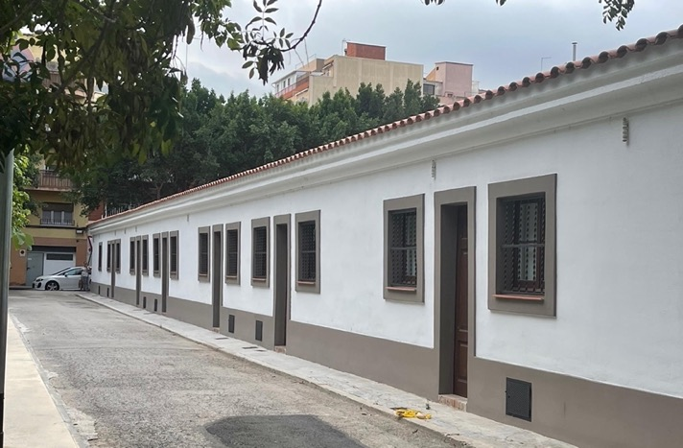
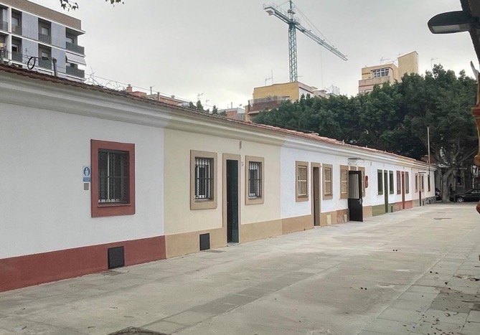
Architectural restitution
Notes:
A Project of architectural restitution: one of the façades was restored as it was in 1929, and the interior hosts a general exhibition, following a modular rythm, compatible with the new uses of the space.
And the other façade was restored as in 2016, when the houses were left, and hosts the preservation of 4 different houses, with some interiors carefully restored to show the evolution of the Cheap Houses.

Slide 23
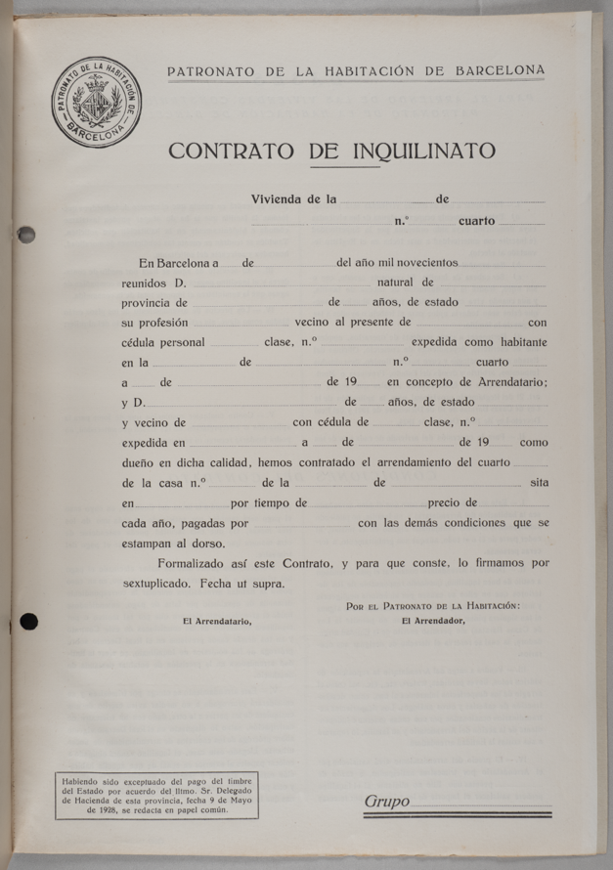
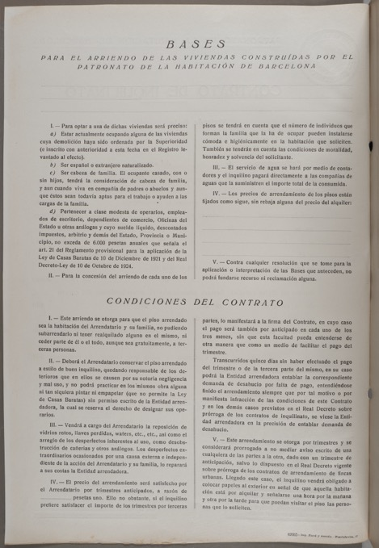
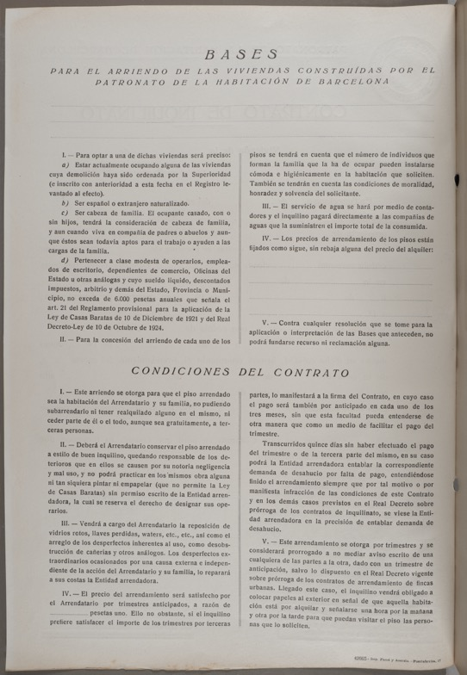
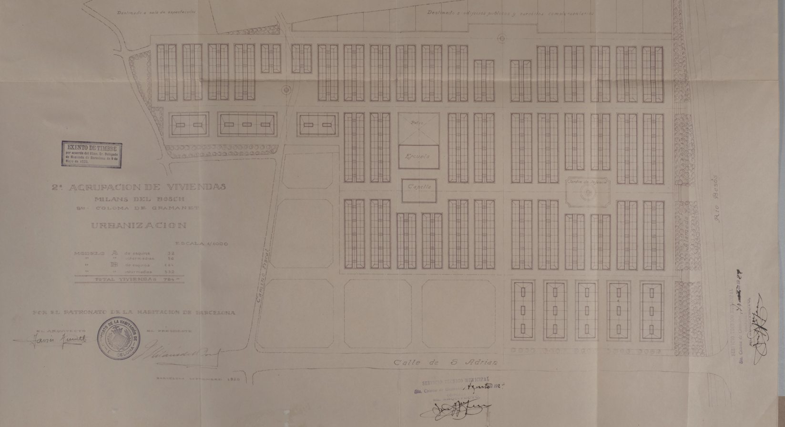
Historiographical research
Notes:
A project, first of all, based on historiographical research. Every action started from the previous scientific study.

Slide 24
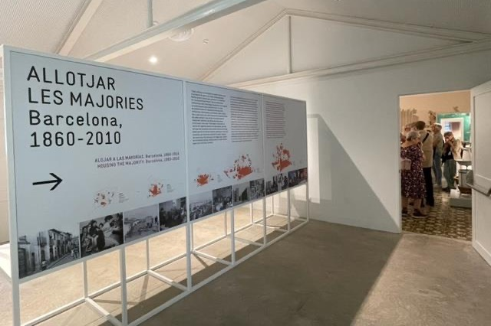
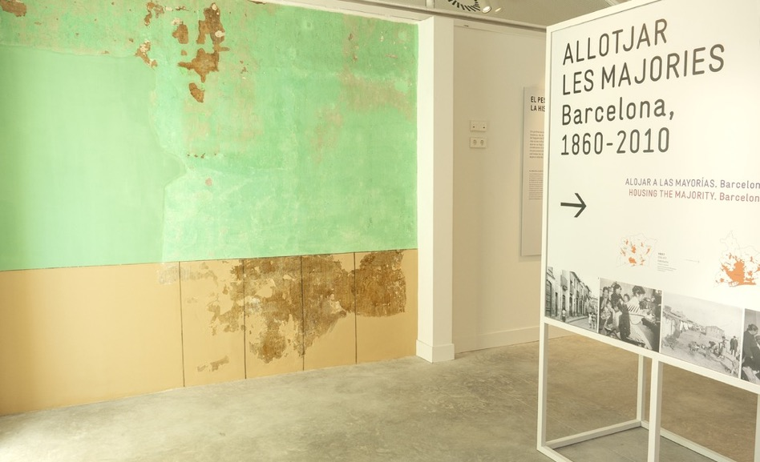
A multiscale approach
The city , the global…
Notes:
A multiscalar Project.
On the one hand, with the general exhibition Housing the majorities → with a city perspective, which shows the trajectory of popular housing in all Barcelona and also with a comparative approach of the history of working-class housing in Europe, with the examples of some other cities

Slide 25
…and the neighbourhood
1929-1952, Shortage
1953-1974, Developmentalism
1975-1993, Renovation
1994-2010, Reframing
Notes:
And at the same time a proximity project that shows the history of the Cases Barates in particular. You can visit 4 houses, each of them restored in a historical way, referring to 4 different periods, in a diachronic view of the working-class life conditions throughout the 20th century.

Slide 26
Compilation of sources
Notes:
The team studied the existing primary sources, obtain oral, written and material documentation, in various city archives and also in family archives.

Slide 27
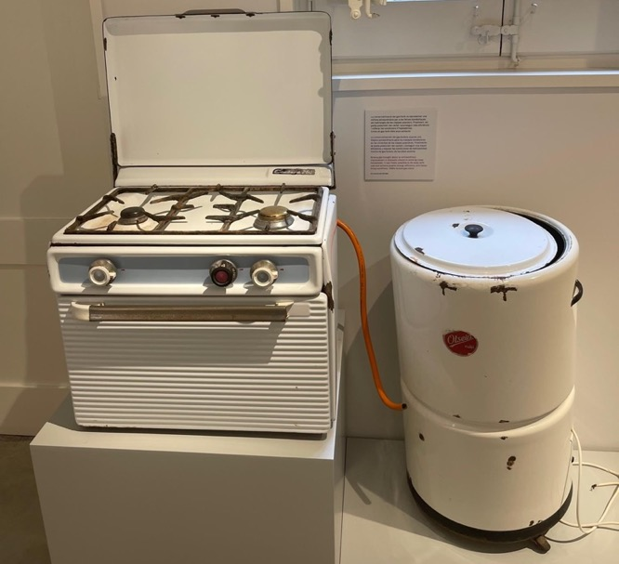
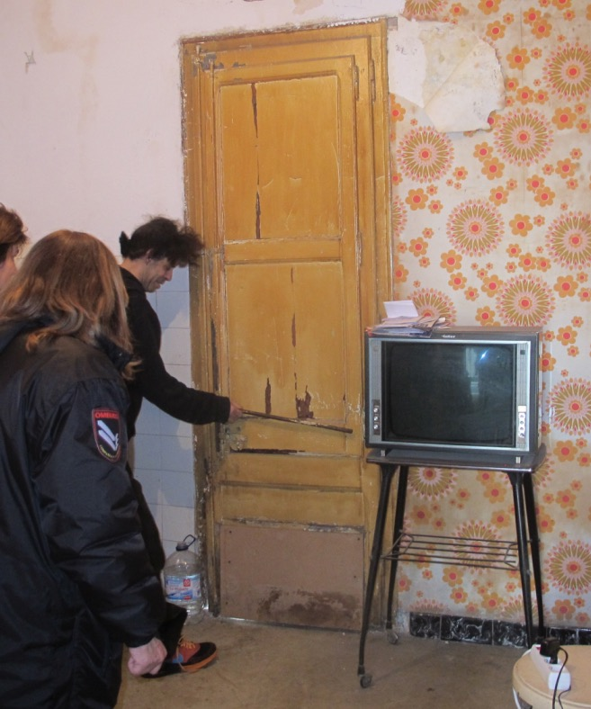
Collecting the city
…with the contribution of citizens
Notes:
…It ‘s a Project of Creating the collection of the Museum, integrating the contemporary daily life of urban majorities in the Museum's holdings and rethinking the most diverse objects.

Slide 28
Raising awareness
Notes:
but also to work in raising awareness to the neighbourhood about the importance of preserving the memory and of contributing with donations and oral testimonies of their experiences.
(*)

Slide 29
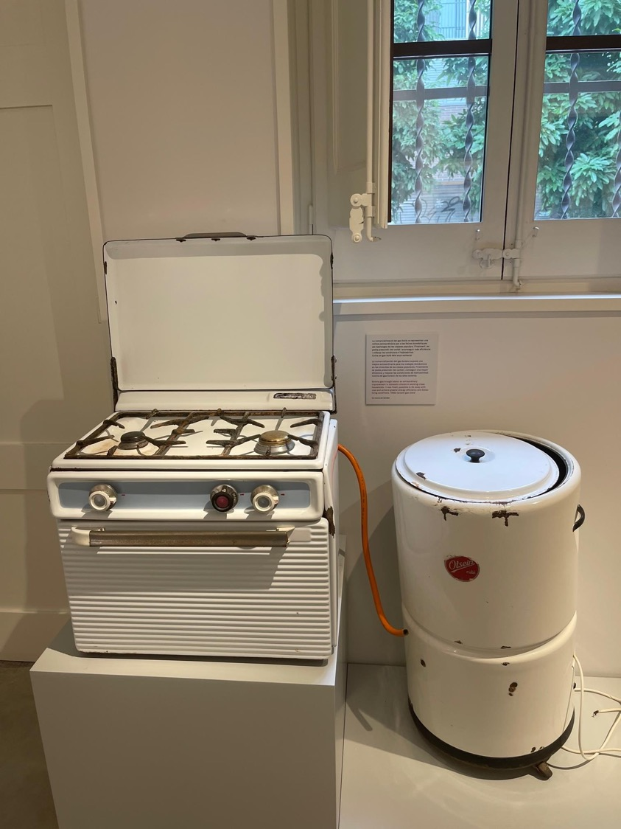
Collecting the city
Notes:
…So, it was also a Project of Creation of the collection of the Museum, integrating the contemporary daily life of urban majorities in the Museum's holdings and rethinking the most diverse objects.
(*)

Slide 30
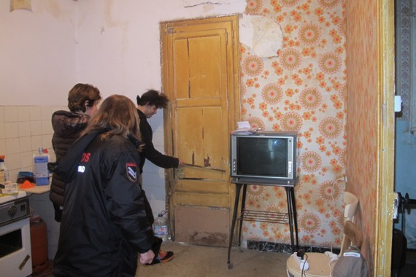
Archaeological monitoring
Notes:
And it’s also a project that has incorporated archaeological monitoring since the first day of intervention, to document and describe the houses and the daily life of the inhabitants.
(*)

Slide 31
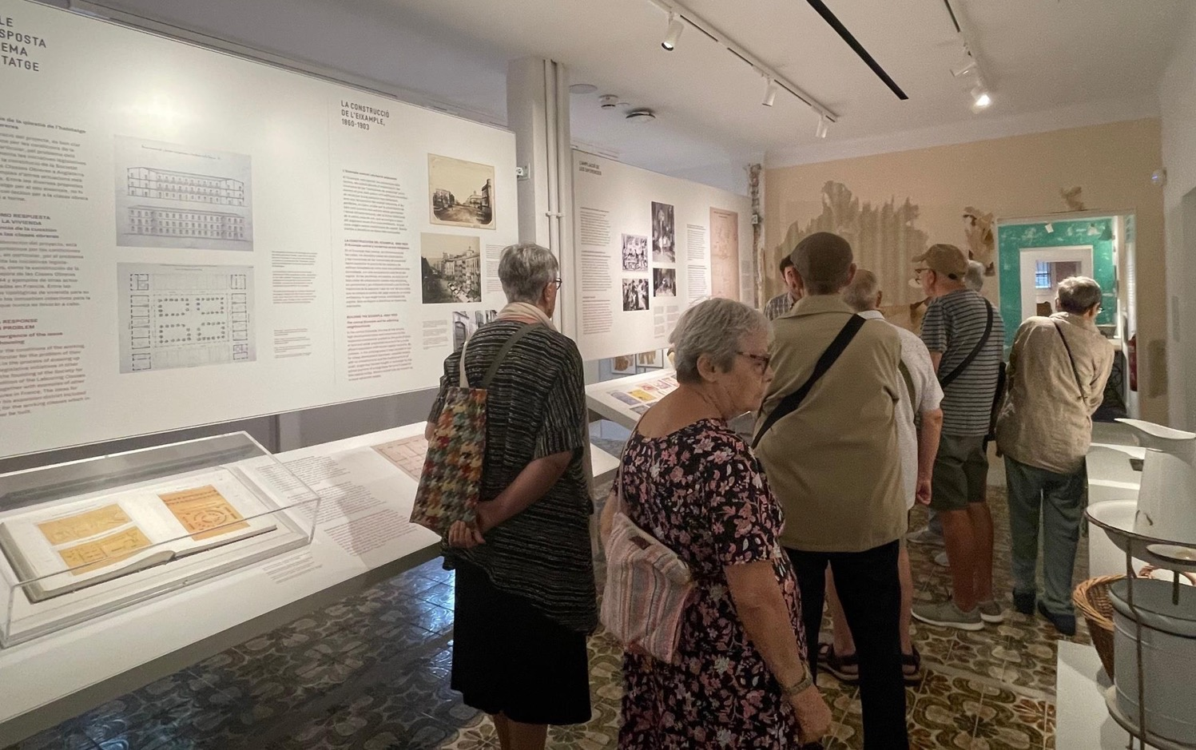
Co-responsibility
Notes:
But the Project didn’t finish with the opening of the site. Actually, shortly after the opening this year, as a significant evolution of the entities' participation in the project, a new entity (the Vilabesòs Study Centre-Archive) has been created ad hoc, signing an agreement of CORRESPONSIBILITY for the management of the site.
This new resident entity is being very, very active, with a very powerful proposal of activities, proposals for studies, (here for example they are doing a guided tour of the exhibition), they even open and close the space...
So, a new model that weaves together culture, territory and citizens in a facility that is both local and urban.
It’s a model of cultural democratization, where the citizen is also a subject who investigates, defines, collaborates and, above all, assumes the co-responsibility and the co-management of the equipment.
(*)

